Slide 1

ADAPTIVE CRUISE CONTROL
PRESENTED BY:-
JAYANT VERMA
KIRAN KUMAR C.R
BHAVANA B.
MB POORNIMA
SAMPADA GHULE

Slide 2
Contents
Introduction
Requirement
Design
System block diagram
Hardware block diagram
Functional block diagram
Sequential flowchart

Slide 3
Introduction
Cruise control is a system, which automatically controls the speed of vehicle and maintain the distance with others vehicle.
The basic operation of cruise controller is to sense the speed of the vehicle, compare this speed of a desired reference and then accelerate or deaccelerate the car as required.

Slide 4
Requirements
Type | Object
Heading | Cruise Control Warning lamp.
Definition | Cruise control is a system, which automatically controls the speed of vehicle and maintain the distance with others vehicle.
 | WARNING LAMP
Requirement | 1.If any fault in the system warning lamp will set ON.
Requirement | 2.If the speed is exceed than limit warning lamp will set ON.
Requirement | 3. CC status is ON warning Lamp set to ON.
Requirement | 4. CC status is OFF warning Lamp Set to OFF.
 | NRCS
Requirement | 1. System warning lamp shall be activated if the NRCS input message is not received.
Requirement | 2. System warning lamp shall be deactivated if the NRCS input message is received .

Slide 5
Requirements
Type | Object
 | CRUISE CONTROL SET
Requirement | 1.Cruise control output warning lamp shall be set OFF when the cruise control is SET.
Requirement | 2.Cruise control output warning lamp shall be set ON when the cruise control is SET.

Slide 6
SYSTEM BLOCK DIAGRAM
NRCS
CAN I/P
Cruise Control
LED1
CC Status
Cruise Control
HW O/P
HW I/P
LED2
NRCS Status
HW O/P
CAN O/P
Vehicle acceleration speed
CC ON/OFF
NRCS Input Status (Valid/Faulty)

Slide 7
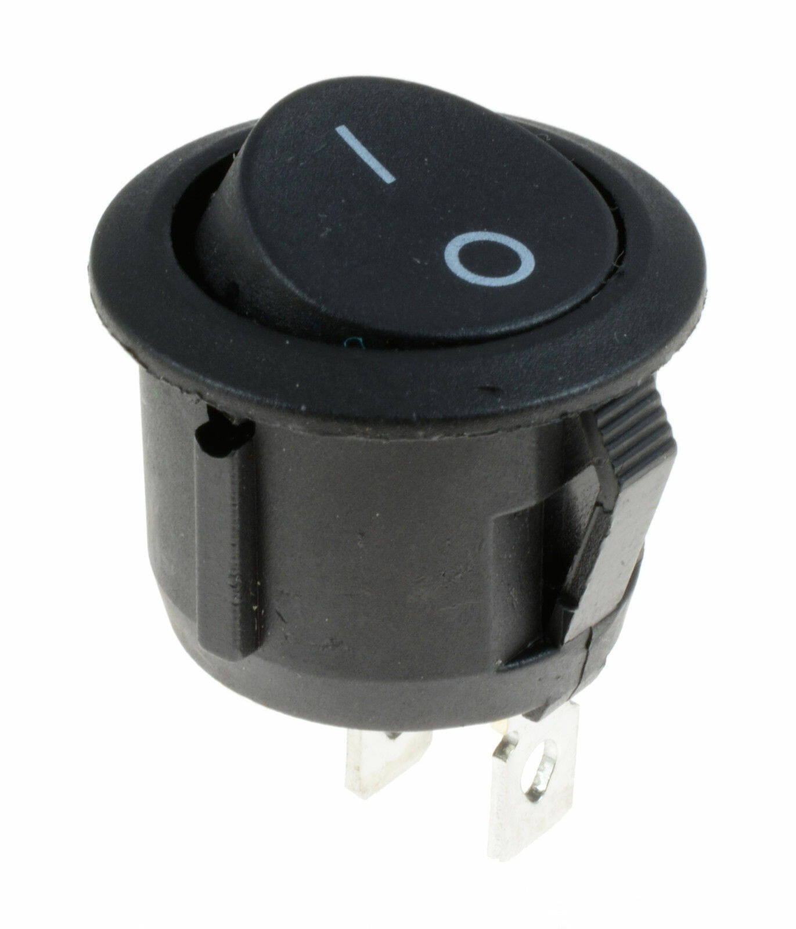

CAN High
Hardware BLOCK DIAGRAM
CAN Low
H
L
IXXAT
CAN Transceiver
H
RX
TX
GND
VCC
L
MICROCONTROLER
RB3
RB2
GND
VCC
CC Warning Lamp
SWITCH
NRCS status WL
EEPROM
Power Supply 5V

Slide 8
Functional BLOCK DIAGRAM
Switch()
System_initialization()
CAN_initialization
Baud_rate()
2
3
CC_main(){
system_initialization()
CAN_initialization()
CC_status()
}
1
CC_status()
4
warning_led()
5
acc_speed()
recieve()
filter()
7
transmit()
6
mask()

Slide 9
SEQUIENTIAL FLOW CHART
SYSTEM INIT
Start
GIE=1
PEIE=1
TRISbits.RC0=0
TRISbits.RC1=0
PORTCbits.RC1=0
LATCbits.LC0=0
TRISbits.RC0=0
INTCONbits.INTOIE=1
Stop

Slide 10
CAN INITIALIZATION
Start
TRISBbits.RB3=1
TRISBbits.RB2=0
PIE3bits.RxBOIE=1
IPR3bits.RxBOIP=1
Configuration Mode
CANCON=0x80
CANSTAT !=0x08
Set baud rate
BRGCON1=0xC1
BRGCON2=0xB1
BRGCON3=0x45
CIOCON=0x20
Normal Mode
CANCON=0x00
Stop

Slide 11
Main()
Start
System_Initialization()
CAN _initialization()
While(1)
Received_speed()
Warning _LED()
Transmit_Speed()
Stop

Slide 12
EEPROM_WRITE
start
EEDATA=data
EEADR=address
EECON2=0x55
EECON2=0xAA
EECON1bits.WR=1
EECON1bits.WREN=1
TRISA=0
EECON1BITS.EEPGD=0
EECON1BITS.CFGS=1
LATA=read
return
Stop

Slide 13
Warning LED
Start
If(LATAbits.LA0==1)
Receive_1=CAN_speed_read
If(receive_1==0)
LATAbits.LA1=1
NO
LATAbits.LA1=0
Stop

Slide 14
Start
TRANSMIT
LATAbits.LA0==0
NO
YES
Receive1 = receive()
Receive2=EEPROM_write(0x00,receive1)
INTCONbits.GIE=1
Receive1=receive()
Receive=EEPROM_write(0x01,receive1)
INTCONbits.GIE=1
Stop

Slide 15
Start
Received speed
Normal mode
RXMOSIDL=RXBOSIDH
RXMOSIDH=RXBOSIDL
RXFOSIDL=0x00
RXFOSIDH=0x00
CANCON=0x00
msg[0]=RXB0D0
msg[1]=RXB0DLC
msg[2]=RXB0SIDL
msg[2]=RXB0SIDH
RXB0CON == 0x00
can_rec=msg[0]
Return can_rec
Stop

Slide 16
Test Cases
Test Case name | Test Case Steps | Expected Results | Obtained Result
Pre-Condition | ECU is Powred ON ECU is Powred OFF | LED should be ON. LED should be OFF.
Warning Lamp | 1. Turn ON the ECU 2. Stop the incoming message to ECU 3.Observe the warning Lamp 4. Start sending the CAN message to the ECU | ECU is Powered ON. ECU is Powred ON Warning lamp is activated Warning lamp is deactivated.
Cruise Control | CC status ON | 1. Warning Lamp is ON.

Slide 17
THANK YOU

